Slide 1


Tech Stack for QTX Projects
9 June 2022 By:- BVSS Ravikanth
*Private & Confidential

Slide 2

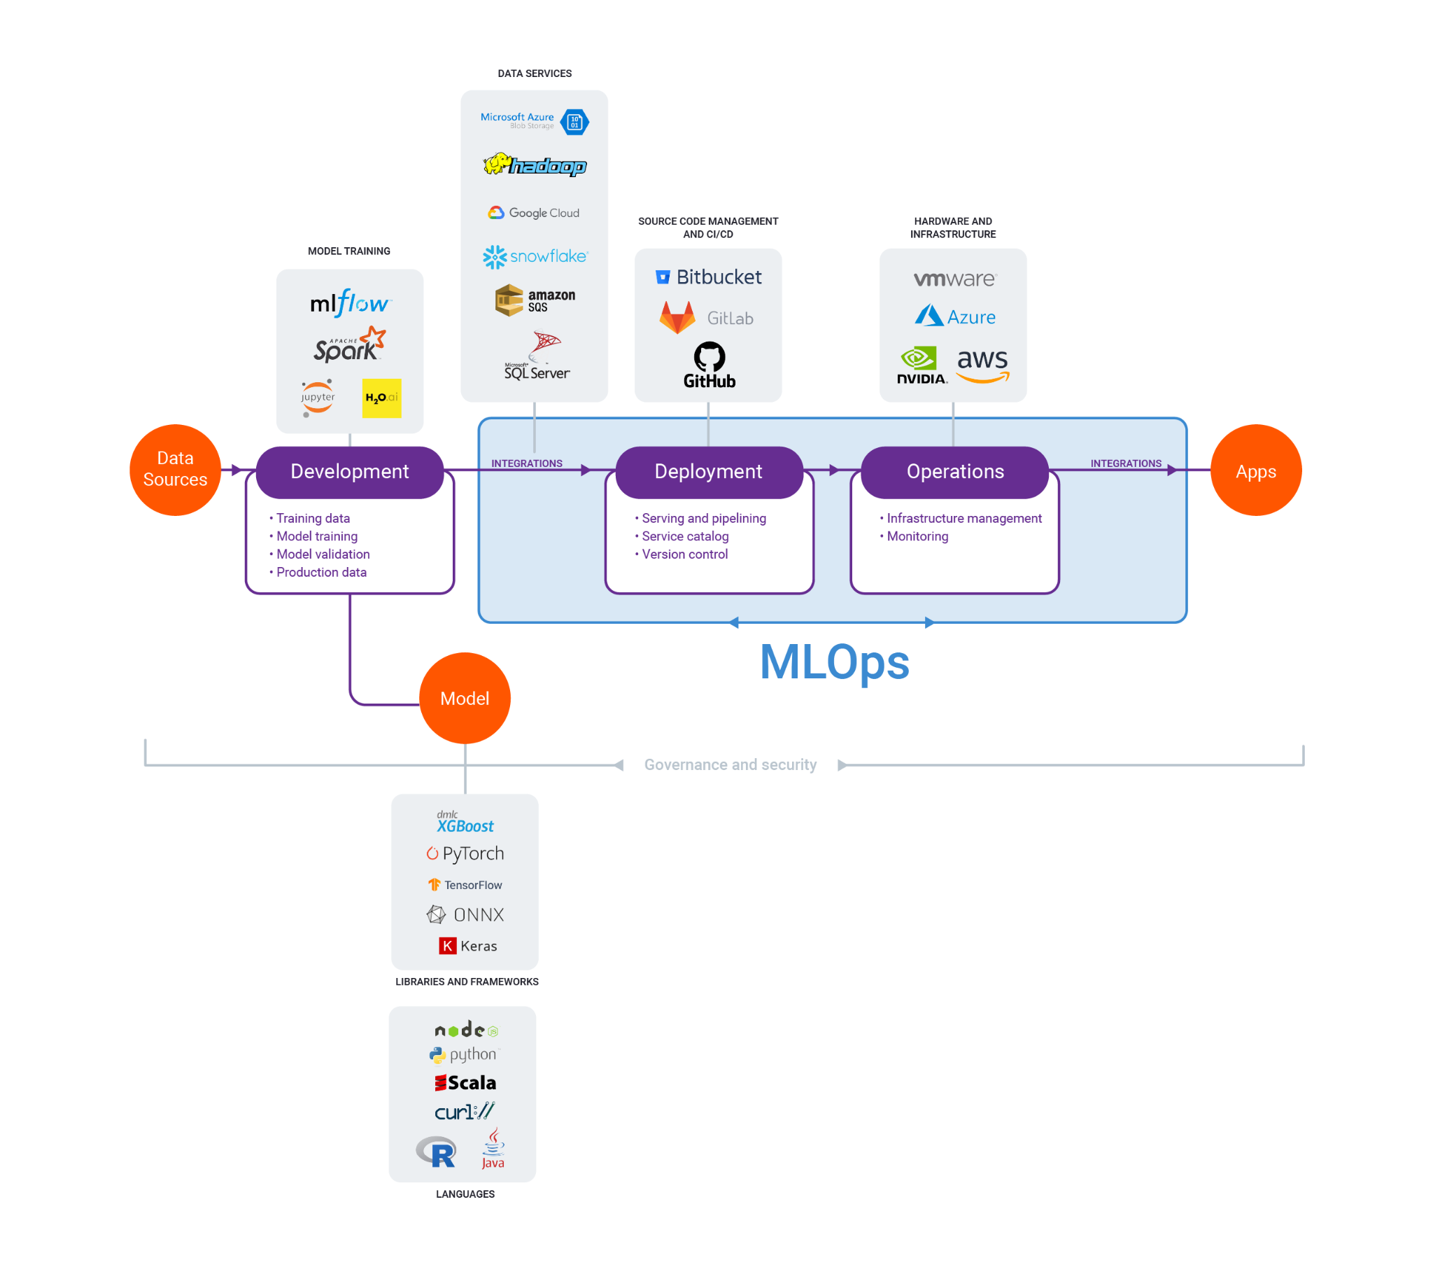
MLOps
Source : https://algorithmia.com/mlops

Slide 3
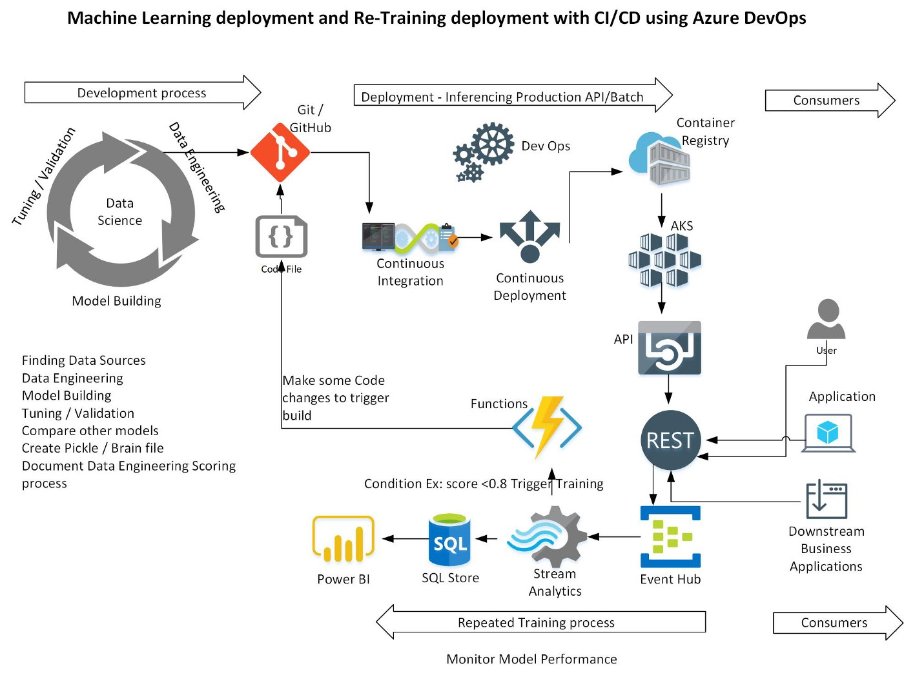
MLOPS
Source : https://medium.com/analytics-vidhya/azure-machine-learning-services-mlops-c0fde346a8ff

Slide 4
MICROSERVICES
What are Microservices?
Microservices are an architectural and organizational approach to software development where software is composed of small independent services that communicate over well-defined APIs.
These services are owned by small, self-contained teams.
Microservices architectures make applications easier to scale and faster to develop, enabling innovation and accelerating time-to-market for new features.
Source : https://medium.com/analytics-vidhya/azure-machine-learning-services-mlops-c0fde346a8ff

Slide 5
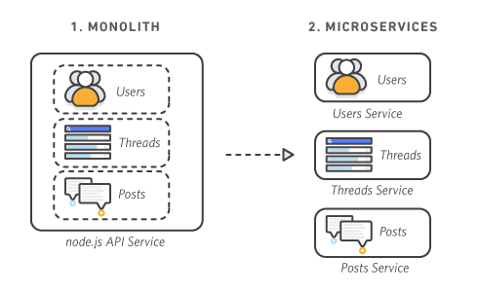
MICROSERVICES
What are Microservices?
Source : https://medium.com/analytics-vidhya/azure-machine-learning-services-mlops-c0fde346a8ff

Slide 6
MICROSERVICES
Tech Stack for microservices?
Python :
Django , Flask
Java :
Spring boot
Source : https://medium.com/analytics-vidhya/azure-machine-learning-services-mlops-c0fde346a8ff

Slide 7
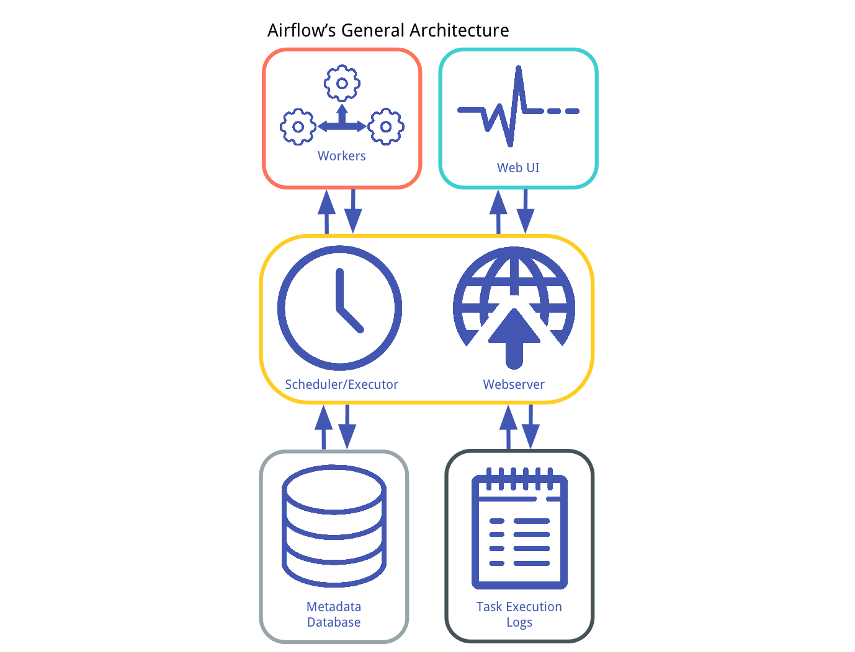
WORKFLOW Manager
Cron Jobs
Airflow
Nifi

Slide 8
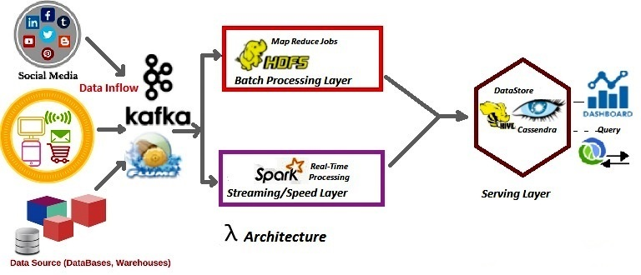
BIG DATA PROCESSING
Source :https://dzone.com/articles/why-lambda-architecture-in-big-data-processing

Slide 9
BIGDATA TecH STACK
HDFS
YARN
Sqoop
Spark
Hive
MongoDB
Kafka
https://sparkbyexamples.com/pyspark-tutorial/
Source : https://medium.com/analytics-vidhya/azure-machine-learning-services-mlops-c0fde346a8ff

Slide 10

Thank You
Notes:
10

